Slide 1

TVS CREDIT E.P.I.C 6 (IT Challenge Case Study)
Round 3 (Case Study Round)
Team Members :- SVS SATHVIK (Leader)
:- SK AZEEM PASHA

Slide 2
TABLE OF CONTENTS
Problem Statement
Understanding the Approach
Project objective
Feature Flow - User’s PoV
Feature Flow - ML model
Workflow
Beneficiaries
Project objective
Conclusion and Work Scope

Slide 3
PROBLEM STATEMENT
01
The current EMI calculator on the website is limited to calculating simple interest, providing only basic outputs without considering the user's unique financial situation. By integrating different types of loan calculators, we can offer a more comprehensive solution.
02
Users don't receive personalized suggestions based on their financial situation regarding the optimal combination of principal, time and interest rate. This makes it difficult for them to choose the best loan plan for their needs.
03
As a result, users might end up making poor loan choices, leading to financial strain and missed opportunities for better loan options.

Slide 4
UNDERSTANDING THE SOLUTION
01
We are going to integrate an AI/ML-powered loan suggester into the existing EMI calculator. This enhancement will not only calculate the EMI but also provide personalized loan recommendations based on user's financial status.
02
The model will analyze various loan options with different principal amounts, interest rates, and durations, and then compare these loans based on the user's financial inputs.
03
We are offering an all-in-one EMI calculator that allows users to calculate EMIs for multiple loans types within the same tool. Users can select different loan types and compare various loan options simultaneously.

Slide 5
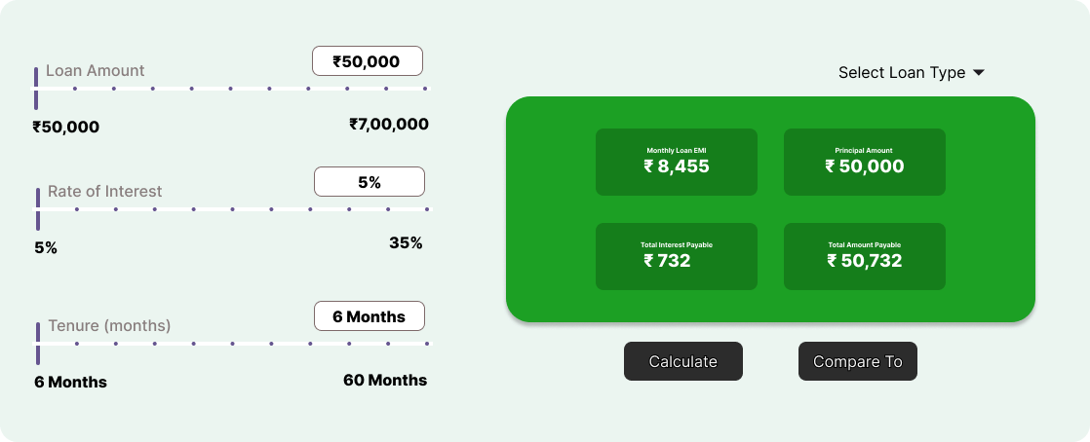
FEATURE FLOW - A USER’S POV
STEP 1:- Read combination of Principal, Time, Rate of Interest(PTR)

Slide 6
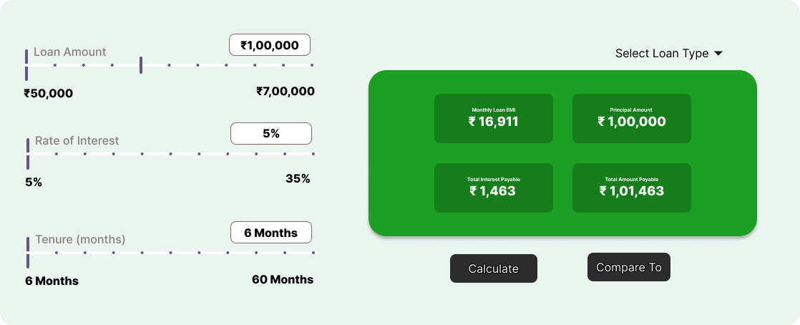
FEATURE FLOW - A USER’S POV
STEP 2:- Add another combination to the comparison set

Slide 7

FEATURE FLOW - A USER’S POV
STEP 3:- Add another combination with different principal amount and time

Slide 8
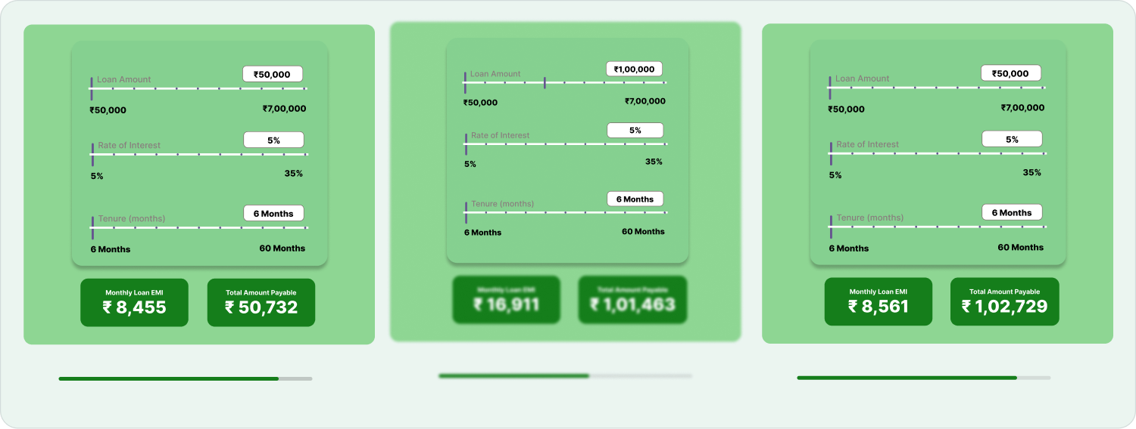
FEATURE FLOW - A USER’S POV
STEP 4:- Hit calculate and obtain the suggestion score for each

Slide 9
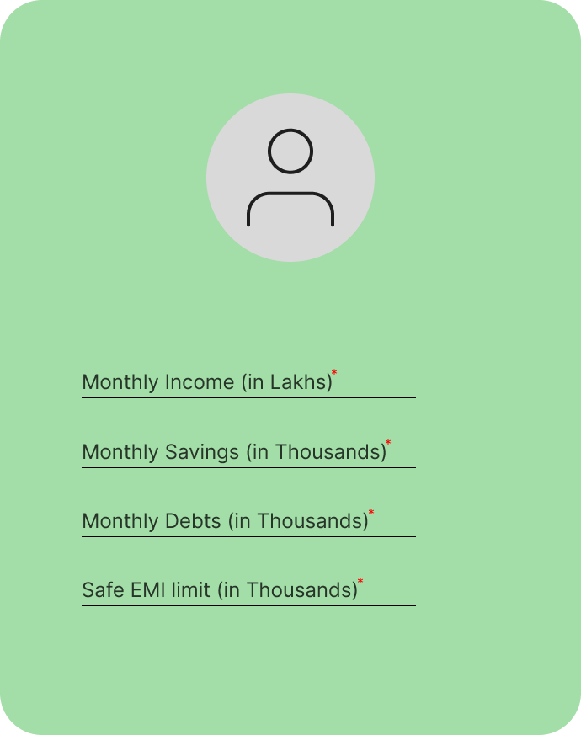
FEATURE FLOW OF TVS-ML MODEL
STEP 1:- Collecting User’s basic financial information

Slide 10
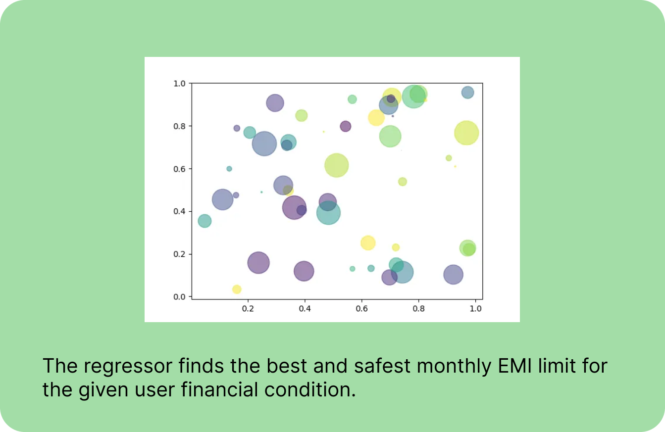
FEATURE FLOW OF TVS-ML MODEL
STEP 2:- Regressor finds the maximum safest EMI limit for user

Slide 11
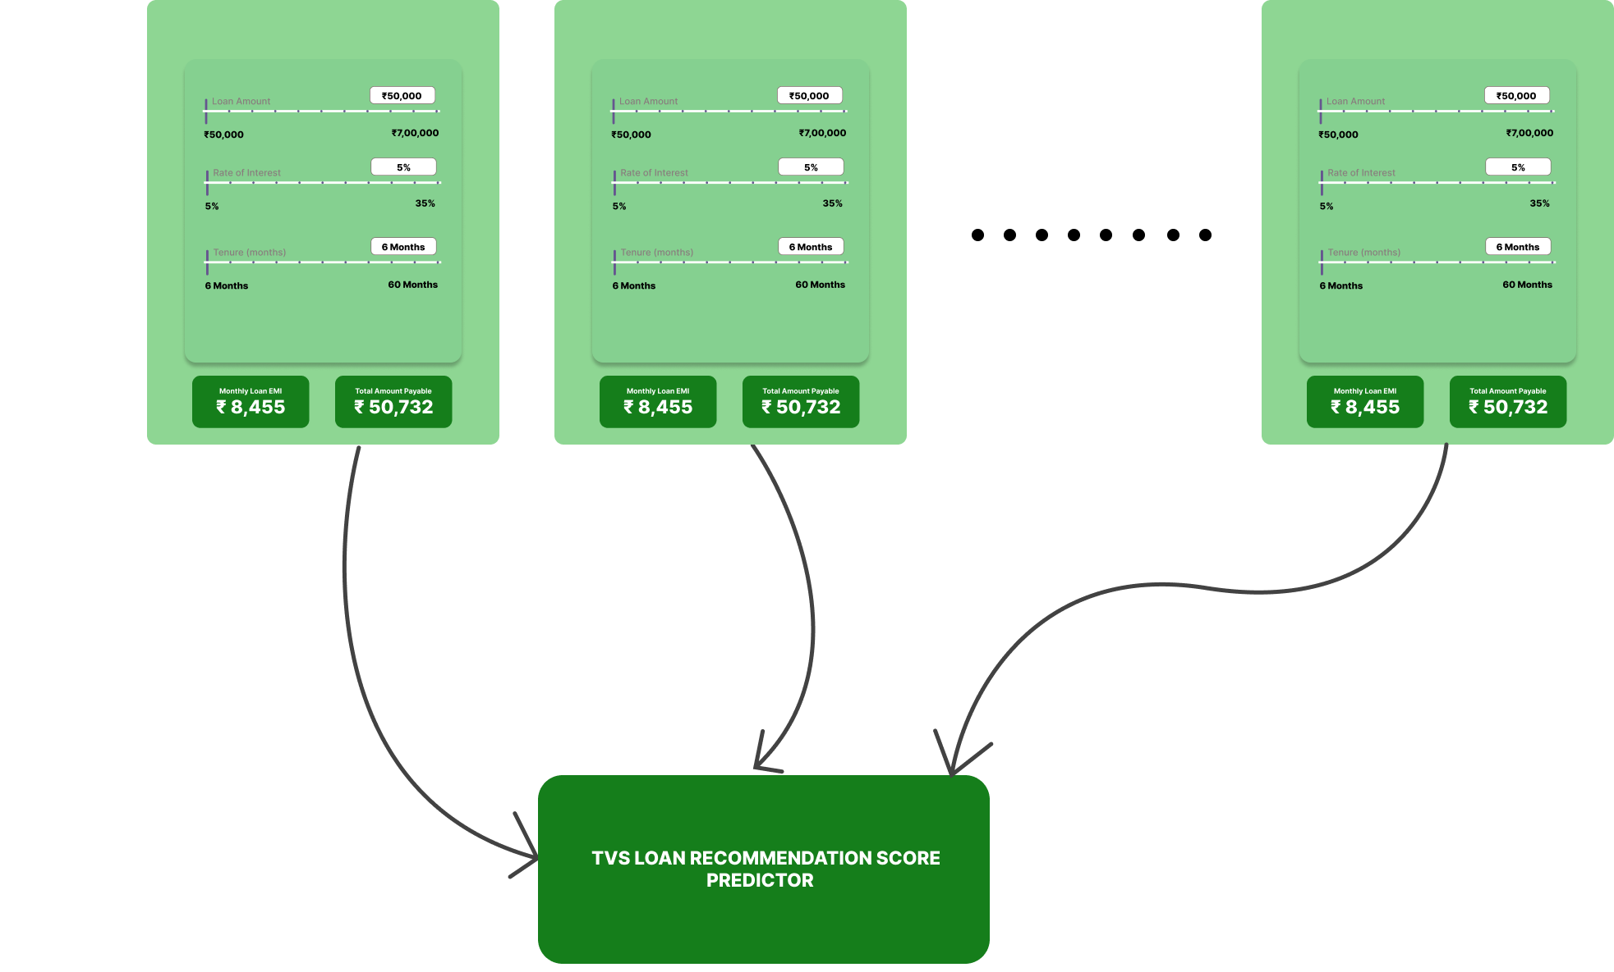
FEATURE FLOW OF TVS-ML MODEL
STEP 3:- Model gets the complete comparison set and identifies monthly strain

Slide 12
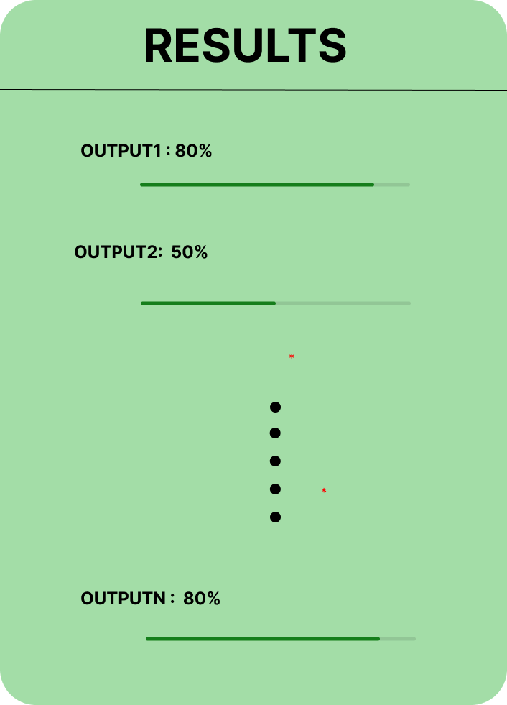
FEATURE FLOW OF TVS-ML MODEL
STEP 4:- Compares the financial status of the user and gives final suggestion scores

Slide 13
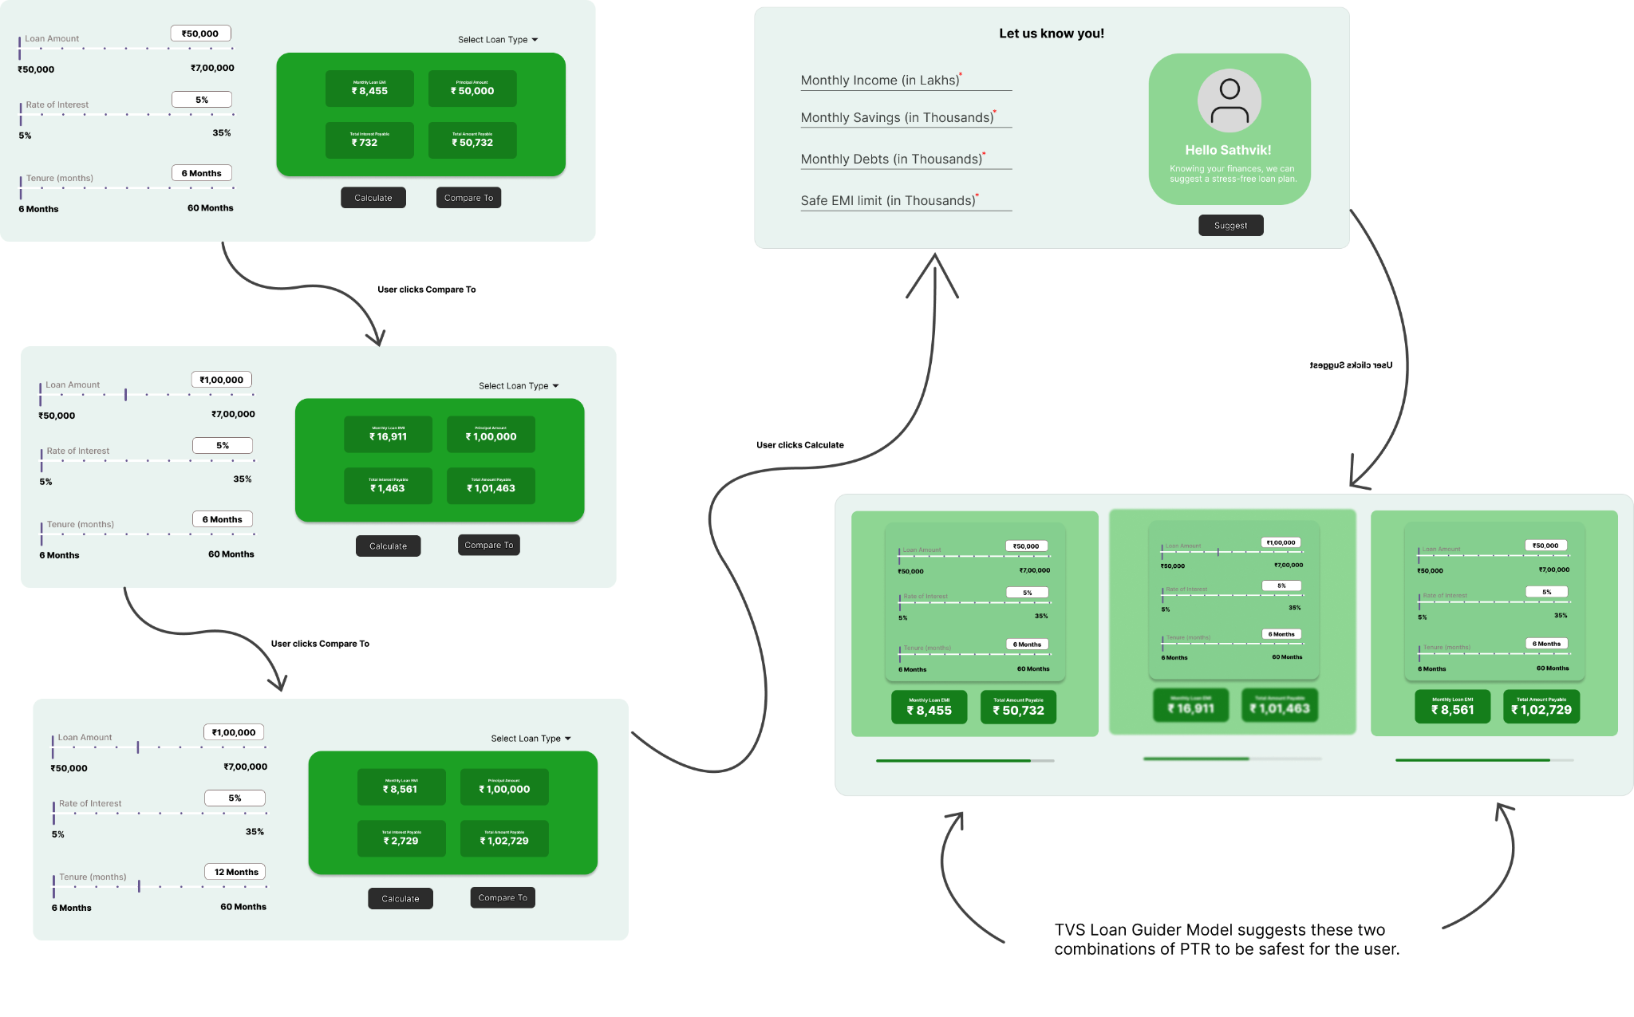
COMPLETE USER FLOW OF TVS-LOAN ADVISOR

Slide 14
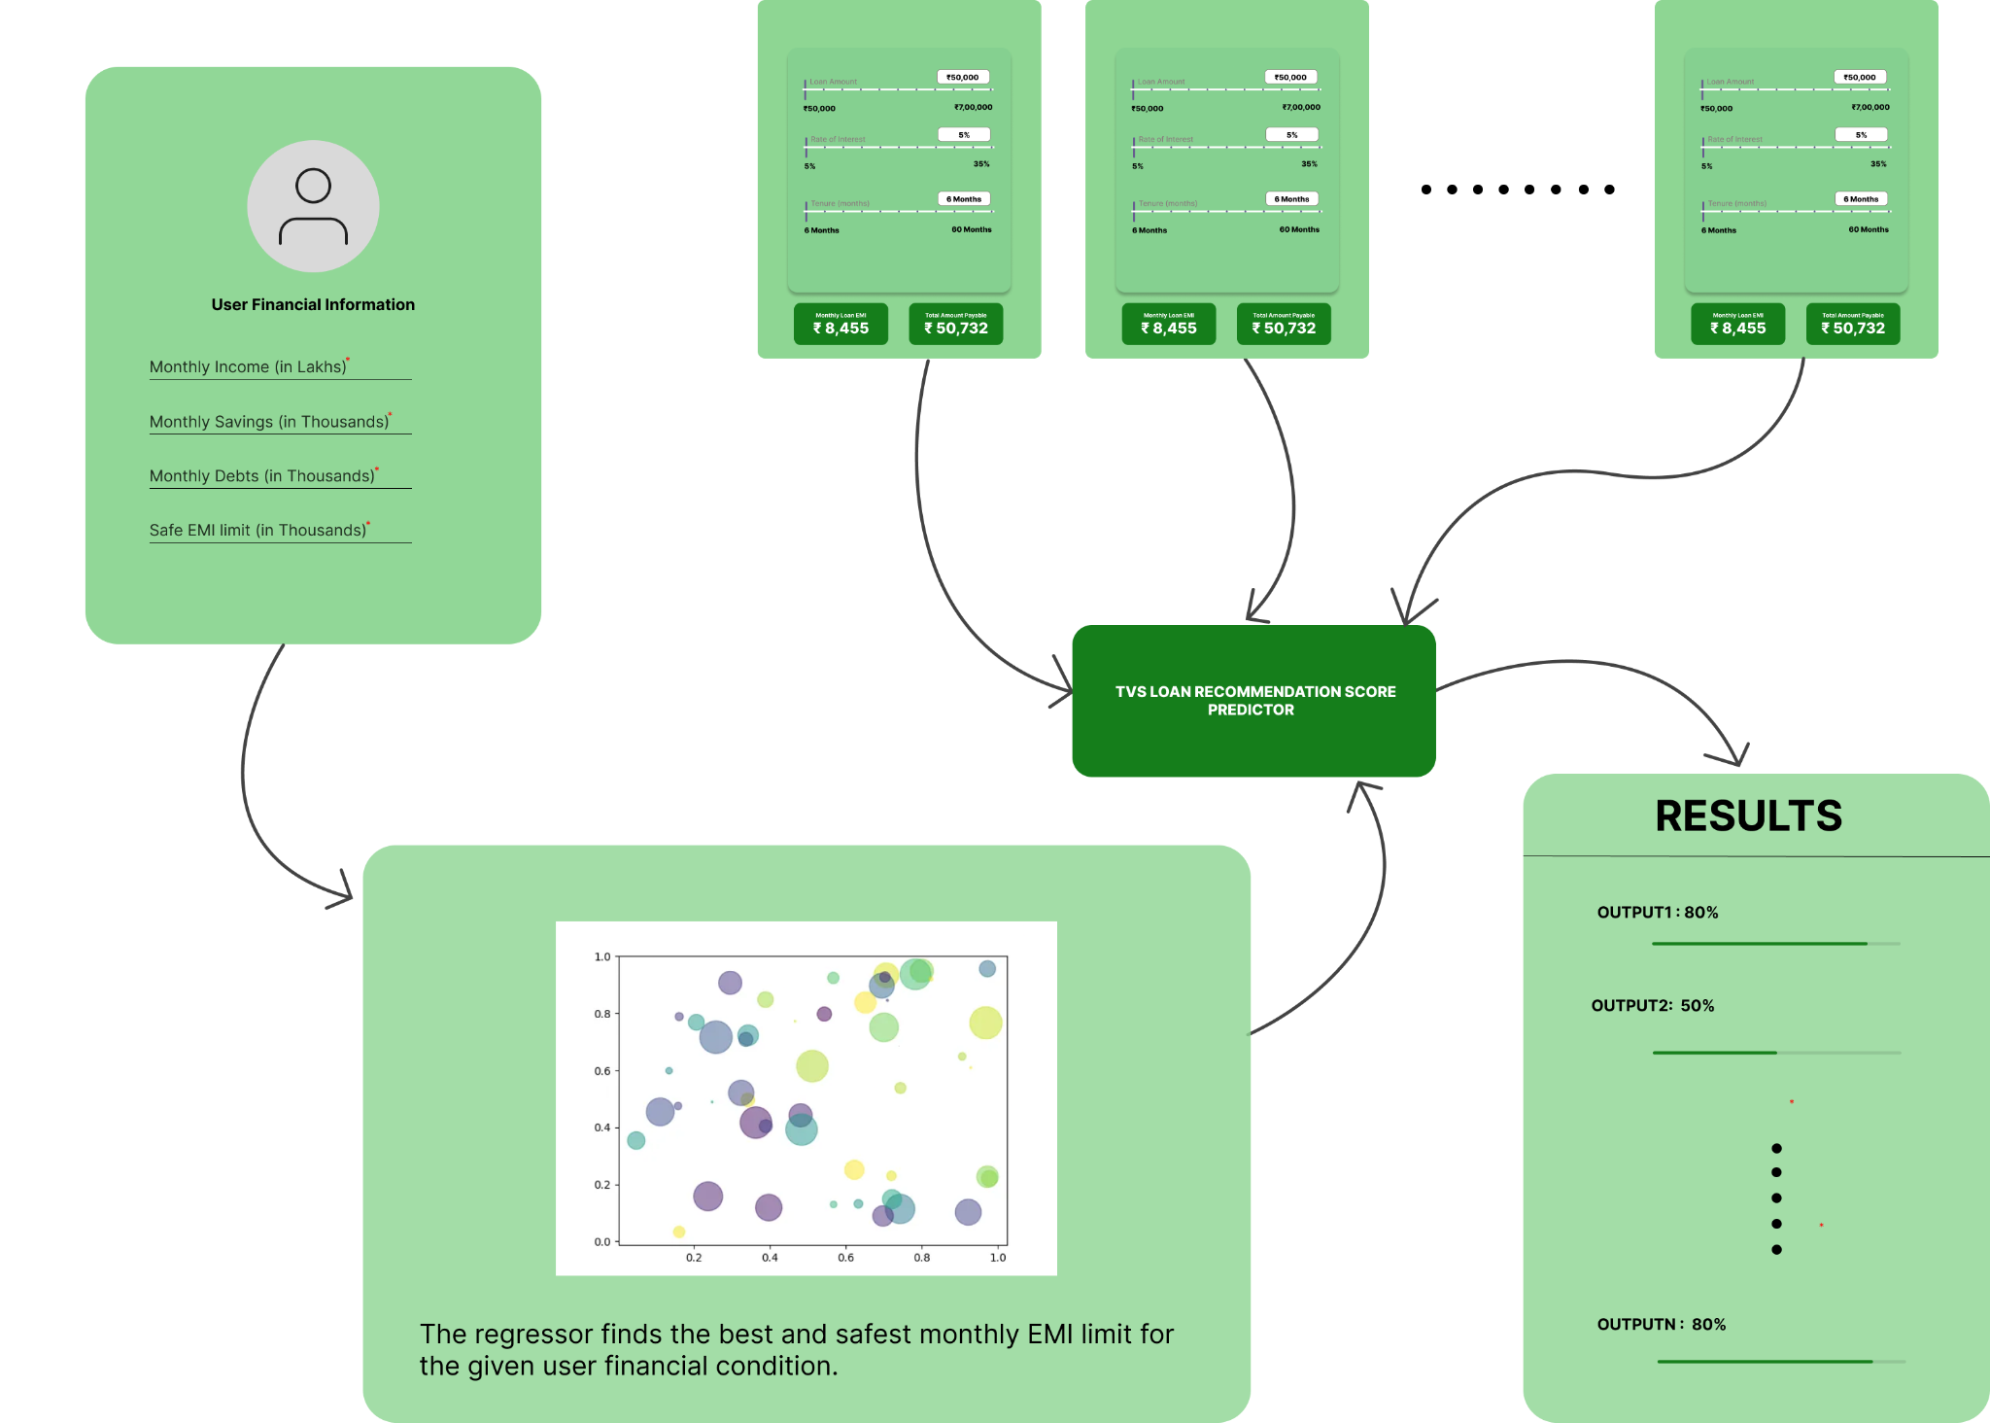
COMPLETE WORKFLOW OF TVS-LOAN ML MODEL

Slide 15
PROJECT SOURCE
Drive Link for Feature Flow - Click here
Drive Link for Proof of concept - Click here

Slide 16
BENEFICIARIES
01
Individual Borrowers
02
Financial Advisors.
03
Banks and Financial Institutions
04
Website Owners.

Slide 17
KEY FEATURES
01
All-in-One EMI Calculator.
02
Personalized Loan Suggestions.
03
Comprehensive Loan Comparison.
04
AI/ML-Driven Insights.

Slide 18
CONCLUSION & WORK SCOPE
The integration of the AI/ML-powered loan suggester into the existing EMI calculator significantly enhances the tool's functionality.
The tool allows users to compare multiple loan options simultaneously, streamlining the loan selection process.
This innovation improves user engagement and satisfaction, benefiting both individual borrowers and TVS Credit.
The project represents a key advancement toward creating a more user-centric financial ecosystem.

